Slide 1
Brief overview of monolingual Portuguese dictionaries [electronic]
Maria Teresa Roberto | Raquel Silva | Sara Carvalho

Slide 2
European Portuguese
Infopédia [https://www.infopedia.pt/]
[2003: launch of the Infopédia platform – Porto Editora]
Priberam [https://www.priberam.pt/dlpo/]
[1996: Dicionário da Língua Portuguesa On-Line is launched]

Slide 3
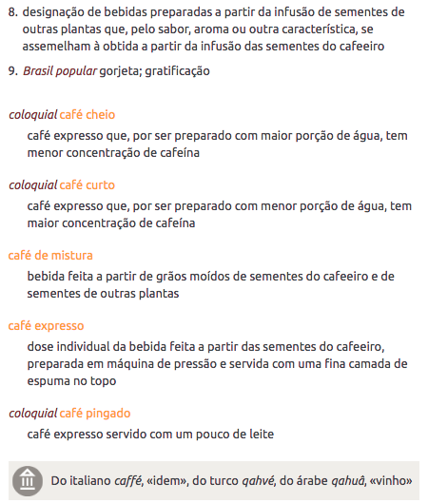
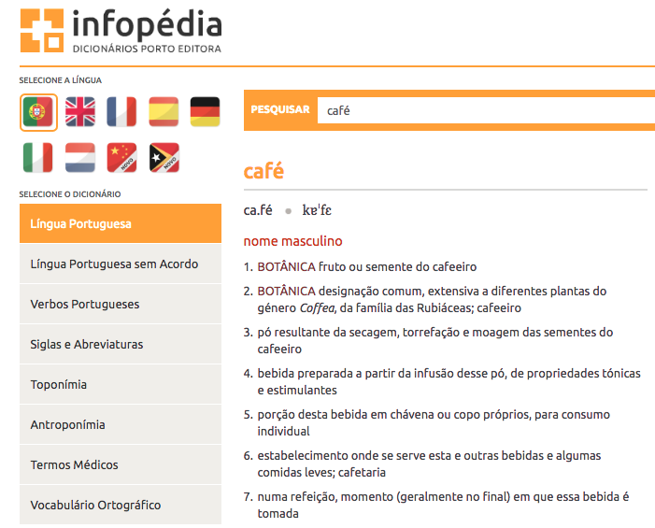

Slide 4

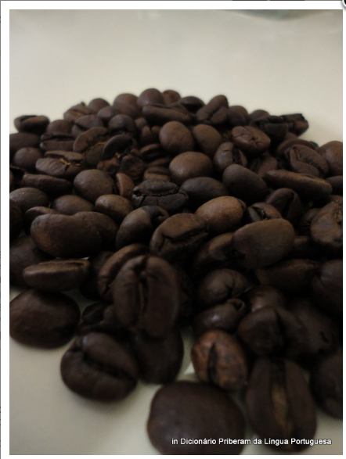
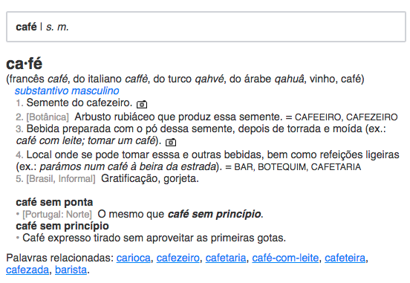
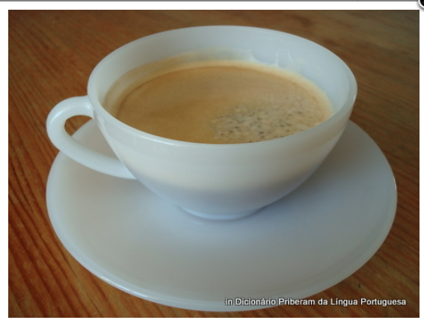


Slide 5
café [overview]
INFOPÉDIA | PRIBERAM
Entry | Entry
Syllable structure | Syllable structure
Phonetic transcription | --------------
Word class | Word class
Meanings [polysemy] | Meanings [polysemy]
Definition | Definition
Reference to the domain | Reference to the domain
Usage [national variants] + language register | Usage + language register
Etymology | Etymology
Examples [terminology] | Examples [regional variants] > terminology?
-------------- | Links to related words
-------------- | Translation support [ESP; ENG; FR]
-------------- | Images

Slide 6
Brazilian Portuguese
Dicionário Aurélio [https://dicionariodoaurelio.com/]
Dicionário Houaiss [https://houaiss.uol.com.br]

Slide 7
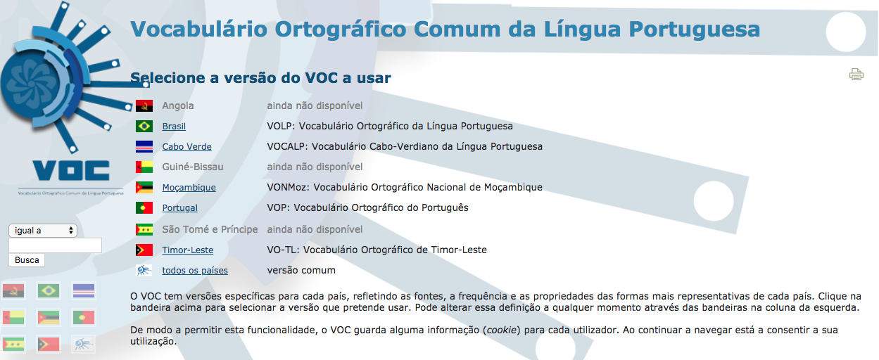
The VOCLP [Vocabulário Ortográfico Comum da Língua Portuguesa]
http://voc.cplp.org/

